Slide 1
Structural Design Patterns
Instructor: Mehroze Khan

Slide 2
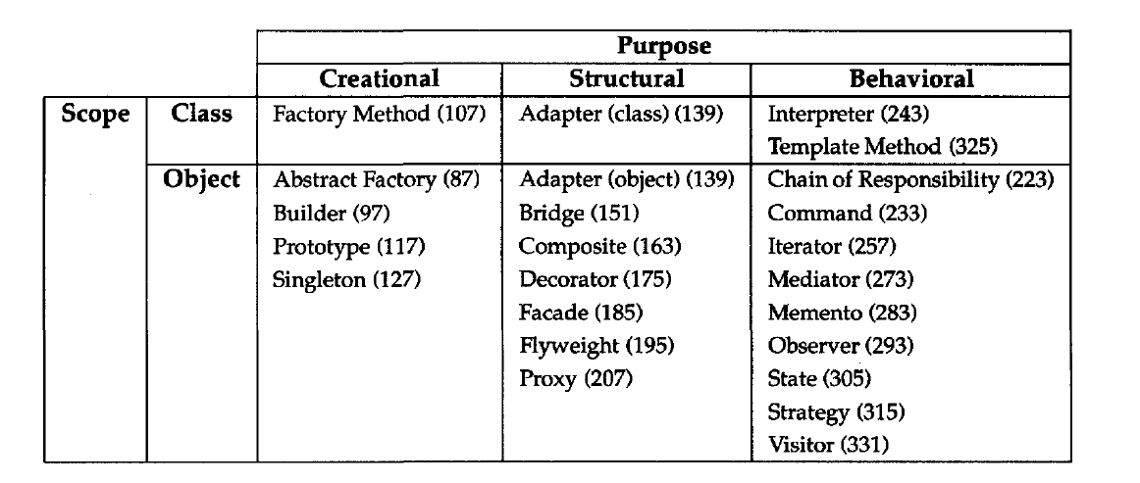
Structural Design Patterns
Structural design patterns explain how to assemble objects and classes into larger structures, while keeping these structures flexible and efficient.
Structural class patterns use inheritance to compose interfaces or implementations.

Slide 3
Adapter Pattern

Slide 4
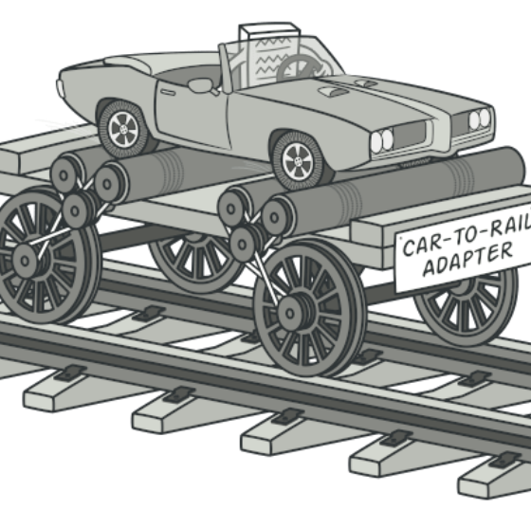
Adapter Design Pattern
Also Known as: Wrapper
Intent:
Adapter is a structural design pattern that allows objects with incompatible interfaces to collaborate.

Slide 5
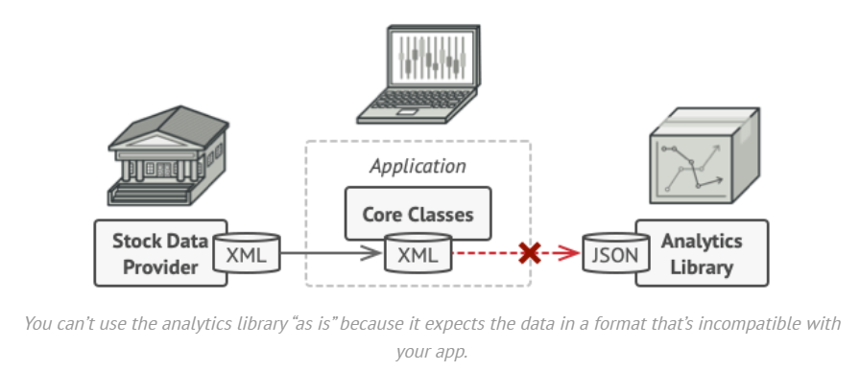
Problem
Imagine that you’re creating a stock market monitoring app. The app downloads the stock data from multiple sources in XML format and then displays nice-looking charts and diagrams for the user.
At some point, you decide to improve the app by integrating a smart 3rd-party analytics library. But there’s a catch: the analytics library only works with data in JSON format.
You could change the library to work with XML. However, this might break some existing code that relies on the library. And worse, you might not have access to the library’s source code in the first place, making this approach impossible.

Slide 6
Solution
You can create an adapter. This is a special object that converts the interface of one object so that another object can understand it.
An adapter wraps one of the objects to hide the complexity of conversion happening behind the scenes.
The wrapped object isn’t even aware of the adapter.
For example, you can wrap an object that operates in meters and kilometers with an adapter that converts all the data to imperial units such as feet and miles.

Slide 7
Solution
Adapters can not only convert data into various formats but can also help objects with different interfaces collaborate.
Here’s how it works:
The adapter gets an interface, compatible with one of the existing objects.
Using this interface, the existing object can safely call the adapter’s methods.
Upon receiving a call, the adapter passes the request to the second object, but in a format and order that the second object expects.
Sometimes it’s even possible to create a two-way adapter that can convert the calls in both directions.

Slide 8
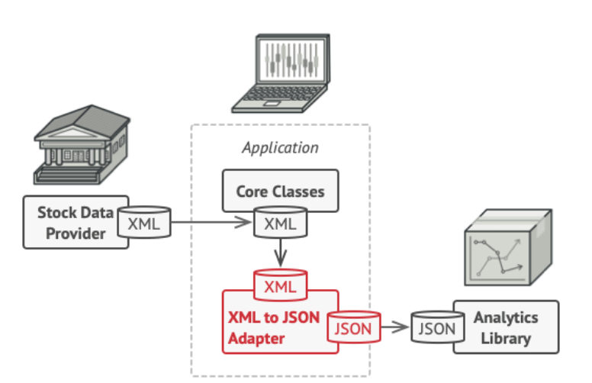
Solution
To solve the dilemma of incompatible formats, you can create XML-to-JSON adapters for every class of the analytics library that your code works with directly.
Then you adjust your code to communicate with the library only via these adapters.
When an adapter receives a call, it translates the incoming XML data into a JSON structure and passes the call to the appropriate methods of a wrapped analytics object.

Slide 9
Structure (Object Adapter)
This implementation uses the object composition principle:
Adapter implements the interface of one object and wraps the other one. It can be implemented in all popular programming languages.

Slide 10
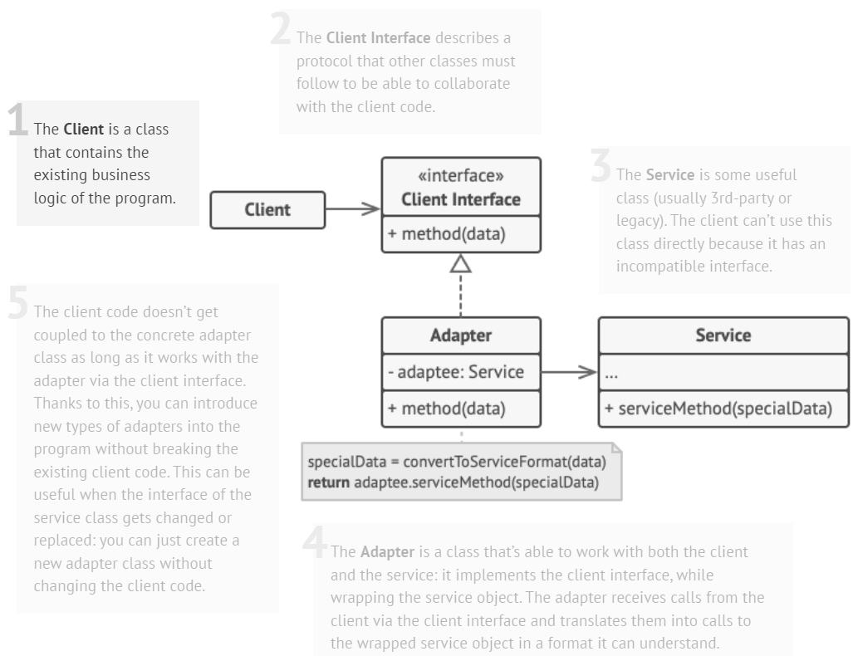
Structure (Object Adapter)

Slide 11
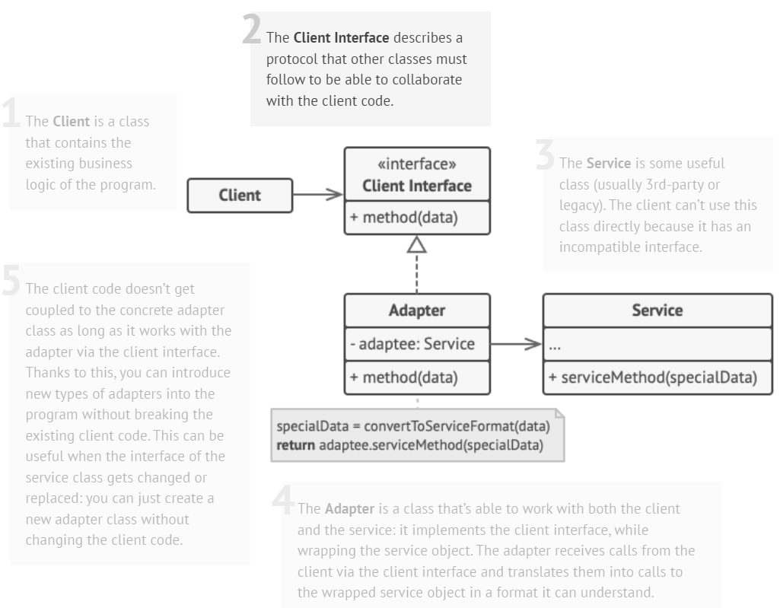
Structure (Object Adapter)

Slide 12
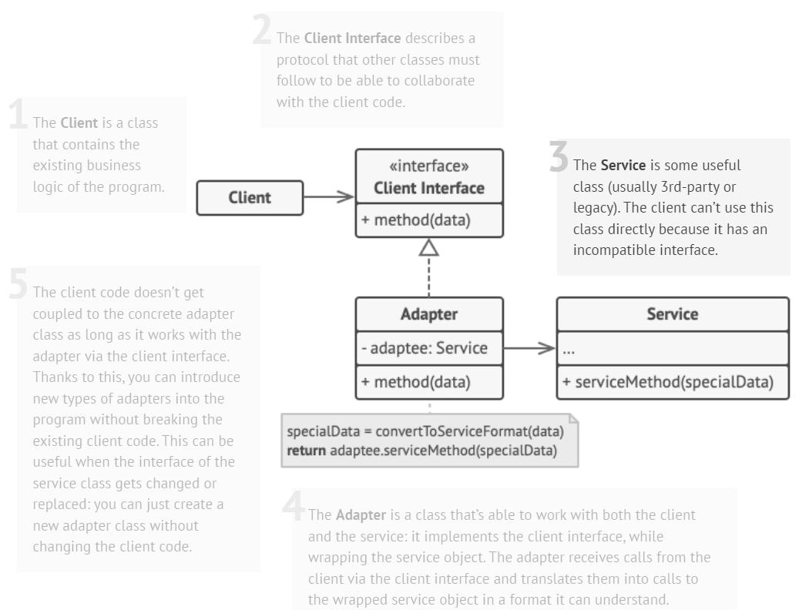
Structure (Object Adapter)

Slide 13
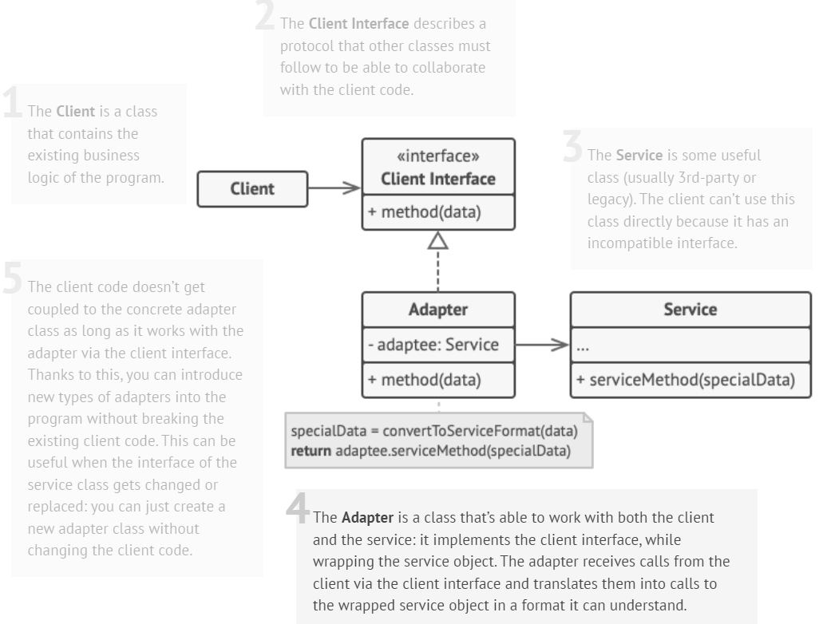
Structure (Object Adapter)

Slide 14
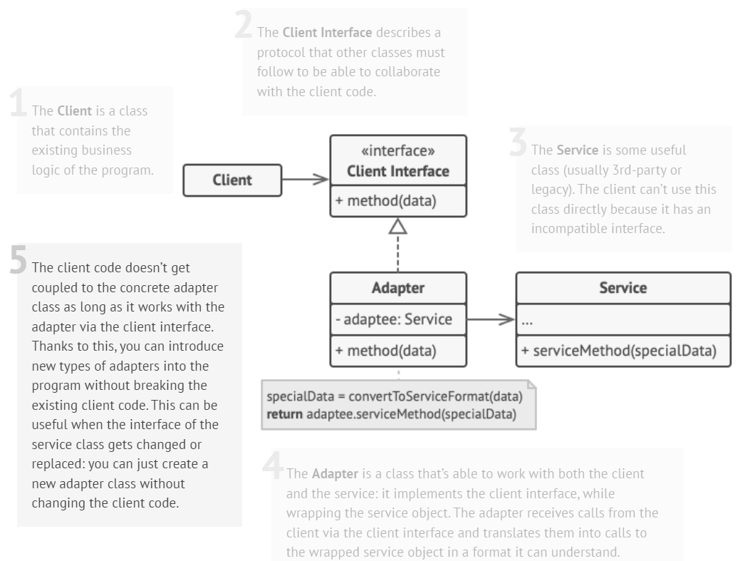
Structure (Object Adapter)

Slide 15
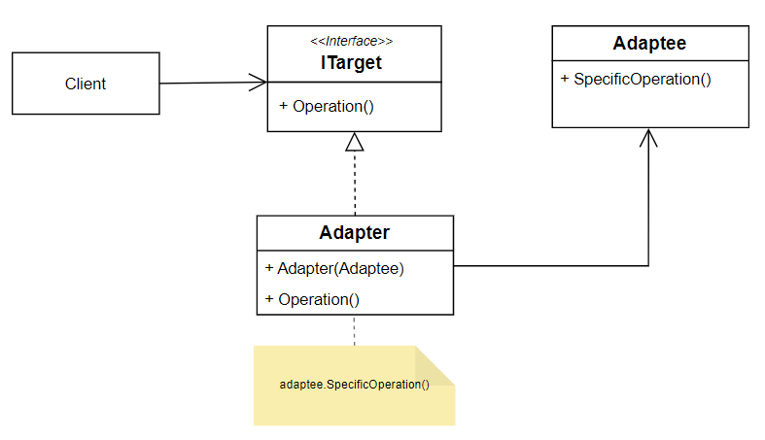
Example (Object Adapter)

Slide 16
Example (Object Adapter)
// Target: Desired interface our client expects
class Target {
public:
virtual void request() = 0;
};
// Adapter: Adapts the Adaptee's interface to the Target interface
class Adapter : public Target {
private:
Adaptee* adaptee;
public:
Adapter(Adaptee* a) {
adaptee = a;
}
void request() override {
// Using Adaptee's specificRequest within the Target's request
adaptee->specificRequest();
}
};
// Adaptee: Existing class with an incompatible interface
class Adaptee {
public:
void specificRequest() {
cout << "Adaptee's specificRequest called" << endl;
}
};
// Client code
int main() {
Adaptee* adaptee = new Adaptee();
Target* adapter = new Adapter(adaptee);
// Client uses the Target interface to call the Adaptee's method
adapter->request();
}
Output:
Adaptee's specificRequest called

Slide 17
Another Example (Object Adapter)
// Target: Represents a universal voltage interface
class Device220V {
public:
virtual void operateAt220V() = 0;
};
// Adapter: Adapts Device110V to operate at 220V
class VoltageAdapter : public Device220V {
private:
Device110V* device;
public:
VoltageAdapter(Device110V* d) {
device = d;
}
void operateAt220V() override {
// Using the Device110V's method within the Device220V's interface
cout << "Adapter converting 220V to 110V." << endl;
device->operateAt110V();
}
};
// Adaptee: Represents a device designed for 110V
class Device110V {
public:
void operateAt110V() {
cout << "Operating at 110V" << endl;
}
};
// Client code
int main() {
Device110V* device110V = new Device110V();
Device220V* adapter = new VoltageAdapter(device110V);
adapter->operateAt220V();
}
Output:
Adapter converting 220V to 110V.
Operating at 110V

Slide 18
Structure (Class Adapter)
This implementation uses inheritance:
Adapter inherits interfaces from both objects at the same time.
This approach can only be implemented in programming languages that support multiple inheritance, such as C++.

Slide 19
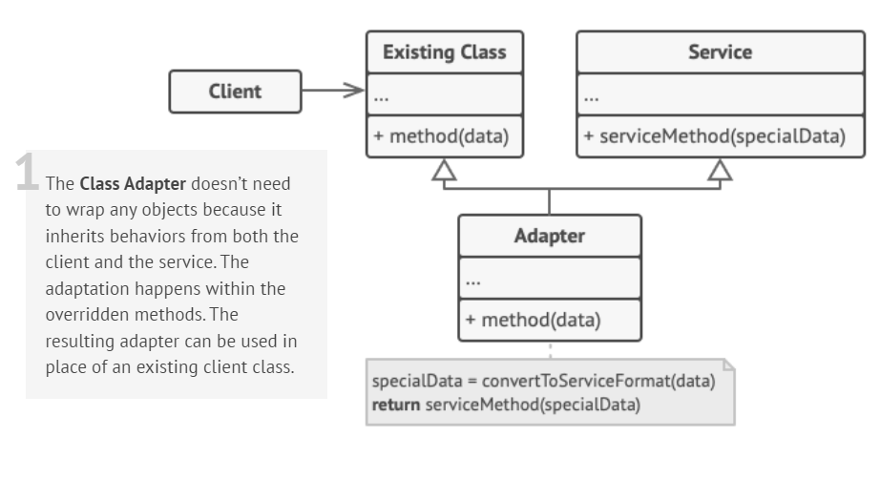
Structure (Class Adapter)

Slide 20
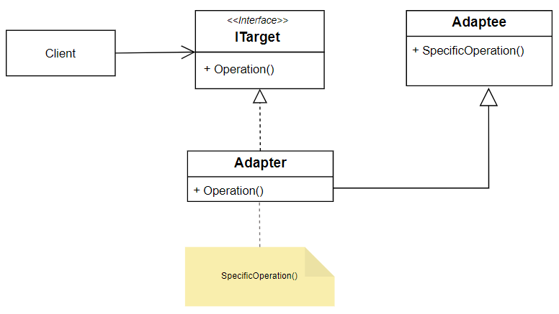
Example (Class Adapter)

Slide 21
Example (Class Adapter)
// Adaptee: Existing class with an incompatible interface
class Adaptee {
public:
void specificRequest() {
cout << "Adaptee's specificRequest called" << endl;
}
};
// Target: Desired interface our client expects
class Target {
public:
virtual void request() = 0;
};
// Adapter: Adapts the Adaptee's interface to the Target interface
class Adapter : public Target, private Adaptee {
public:
void request() override {
// Using Adaptee's specificRequest within the Target's request
specificRequest();
}
};
// Client code
int main() {
Target* adapter = new Adapter();
// Client uses the Target interface to call the Adaptee's method
adapter->request();
}
Output:
Adaptee's specificRequest called
Notes:
The Adapter is designed to expose the Target interface to the client. The client should interact with the Adapter only through the Target interface, without knowing about the Adaptee or its details.
By inheriting Adaptee as private, the Adapter ensures that the Adaptee's methods and properties are not directly accessible to the client. This prevents misuse and enforces a clear separation between the client's expectations and the Adaptee's functionality.
private inheritance means that the public and protected members of Adaptee become private members of the Adapter. These members are not visible or callable by the client code that interacts with the Adapter.

Slide 22
Class Adapter Pattern
Implementation:
In the Class Adapter pattern, adaptation is achieved through class inheritance.
The adapter class extends both the target interface (the desired interface the client uses) and the adaptee class (the class with an incompatible interface).
Pros and Cons:
Pros: Simpler structure, as it uses inheritance to adapt the interfaces.
Cons: It's inflexible when dealing with multiple inheritance limitations (e.g., in languages that do not support multiple inheritance, like Java).

Slide 23
Object Adapter Pattern
Implementation:
In the Object Adapter pattern, adaptation is achieved through composition.
The adapter contains an instance of the adaptee class, allowing it to delegate the calls from the target interface to the adaptee.
Pros and Cons:
Pros: More flexible and versatile, as it doesn't rely on inheritance. It can adapt multiple adaptee classes by containing different instances.
Cons: Can result in more code due to the need for delegation methods and can be more complex to manage multiple instances.

Slide 24
References
Design Patterns: Elements of Reusable Object-Oriented Software, Erich Gamma, Richard Helm, Ralph Johnson, and John Vlissides, Pearson, 1995.
Helping Links:
https://refactoring.guru/design-patterns/
https://sourcemaking.com/design_patterns/
https://www.youtube.com/watch?v=Q1jZ4TI6MF4&t=297s&ab_channel=Telusko

